Slide 1
Studio ShodwE
Final Project
Presentation
TEAM A
Drew Feig
Eleanor Fitzgerald
Estelle Darcy
Donna Stroupe

Slide 2
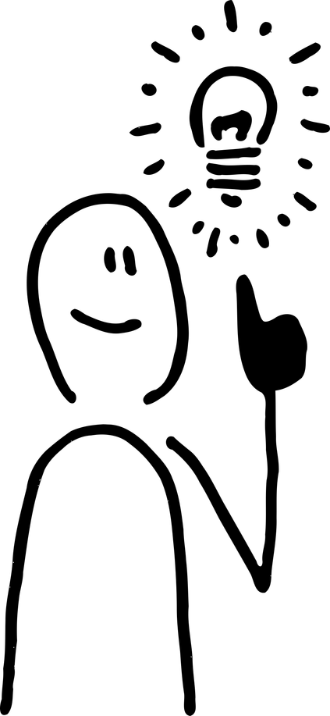
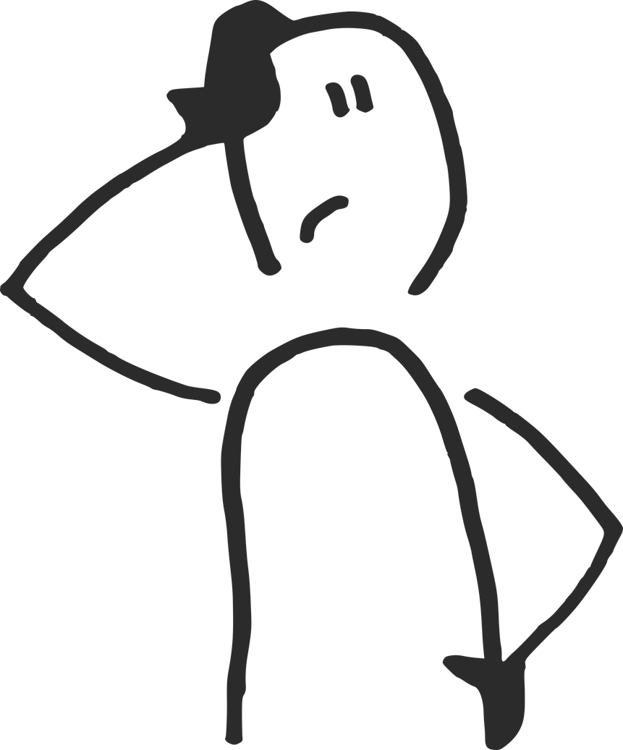
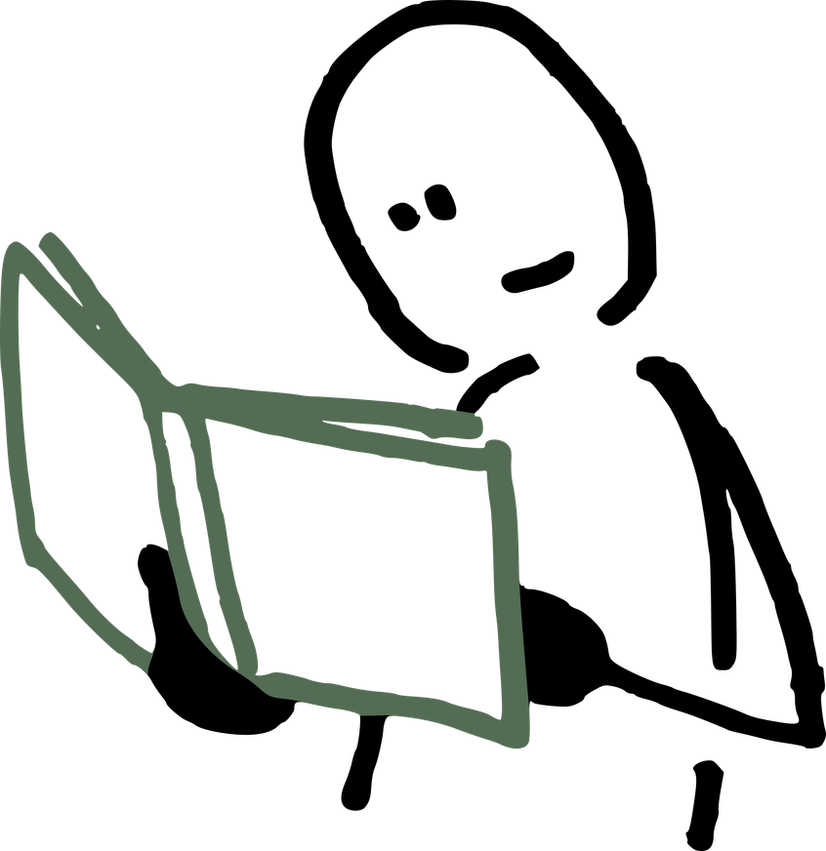
Introduction
Team A
Project Overview
Problem
Solution
Why It Matters
We noticed that many students struggle with staying organized during final exams, leading to stress and missed deadlines.
We designed a digital planner system specifically for university students to help manage tasks, track deadlines, and reduce stress.
By making organization intuitive and accessible, this tool supports academic success and improves student well-being.
2

Slide 3
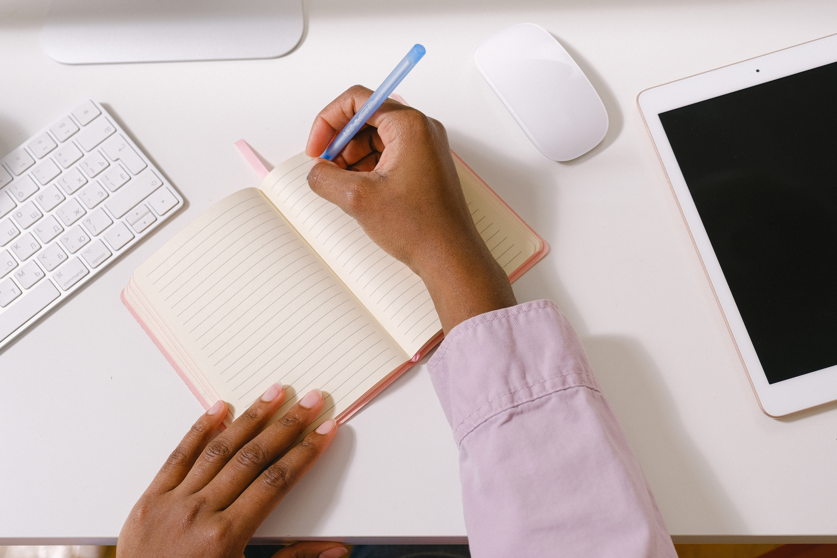
Introduction
Team A
Project Objective
Main Goal
To create a simple, user-friendly planner that helps students manage deadlines, reduce stress, and stay focused during exam periods.
Supporting Objectives
Design an intuitive interface suitable for mobile and desktop use
Include task tracking, reminders, and time-blocking features
Keep the system lightweight, offline-friendly, and distraction-free
3

Slide 4
Background Research
Team A
What We Found
1
2
3
2/3 of students we surveyed said they feel “overwhelmed” during finals.
1-on-1 interviews revealed students want a system that feels personal, not overwhelming.
Most rely on scattered notes or mobile reminders, which often get ignored.
Key Insight
Students don’t lack tools — they lack tools that work the way they think.
4

Slide 5
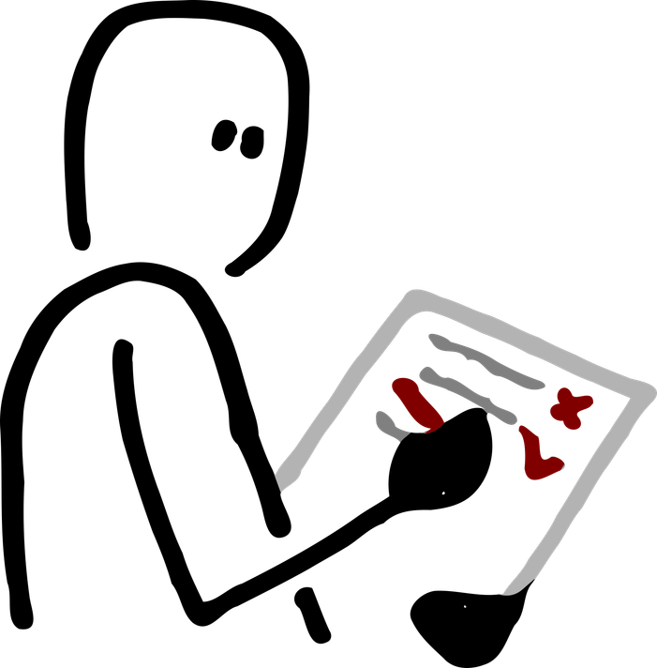
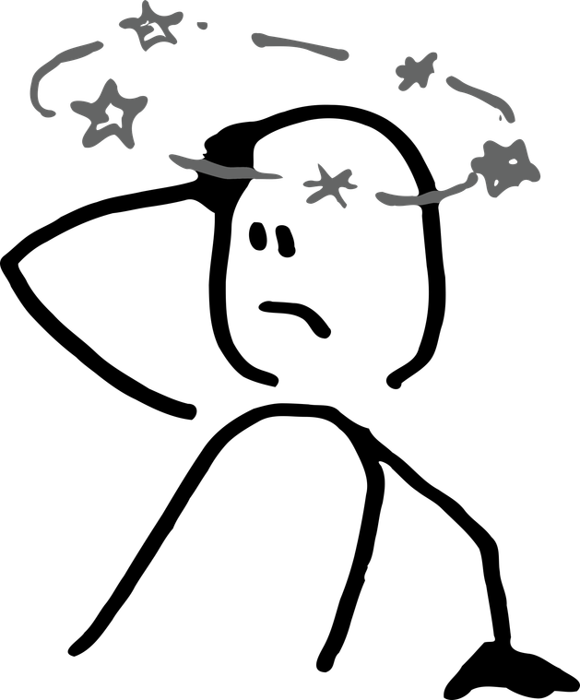
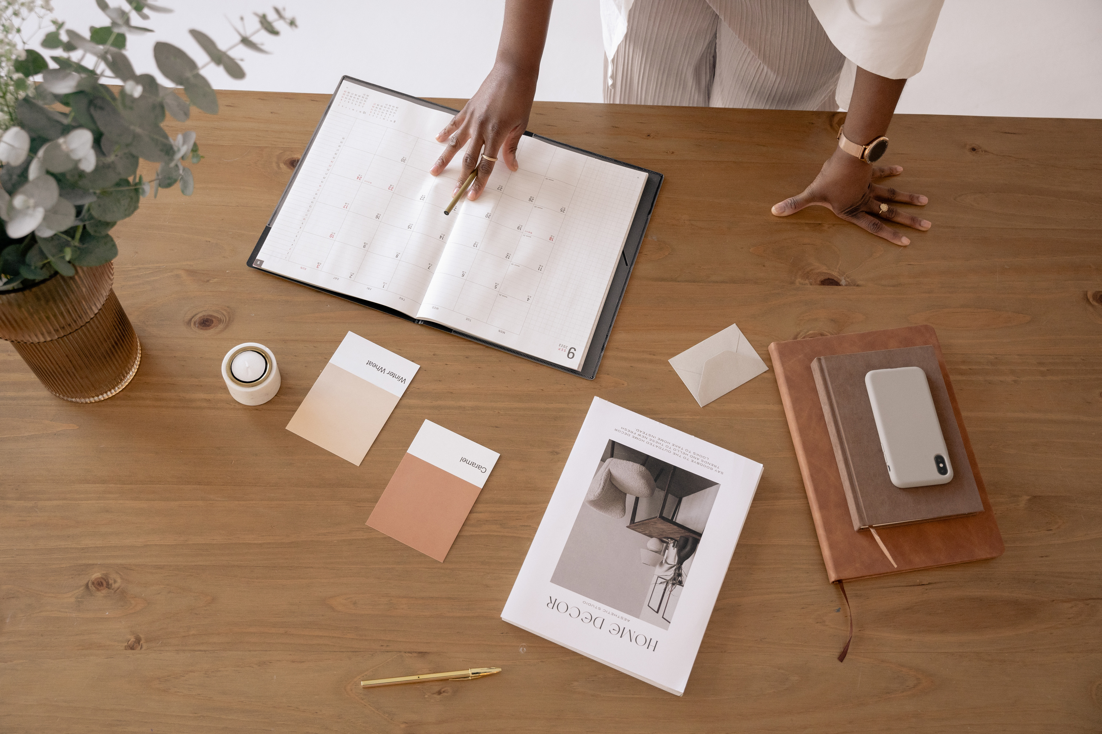
Target Audience
Team A
Who We Designed For
Target User
Their Challenges
College students between 18–24 years old, balancing academics, part-time jobs, and personal life.
Struggle with managing time and deadlines
Easily distracted by phones or unstructured routines
Feel overwhelmed by traditional productivity apps
5

Slide 6
Concept Development
Team A
Who We Designed For
Brainstorm
User Feedback
Concept Sketches
Final Idea
Our initial concept was a simple planner app to help students track assignments.
Feedback showed students felt overwhelmed by typical apps
We explored visual and tactile planning tools
Inspiration from bullet journaling, habit tracking, and minimal design
A flexible digital planner that uses visual blocks and subtle reminders to help students stay on track without pressure.
6

Slide 7
Concept Development
Team A
Methodology
Research
Prototyping
Final Build
We conducted surveys and informal interviews to understand student pain points.
We created wireframes and mockups to visualize the user flow and core features.
Ideation
Feedback & Revisions
Brainstorming sessions with moodboards and concept sketches helped us narrow our focus.
We gathered peer feedback and refined the layout to improve clarity and usability.
7

Slide 8
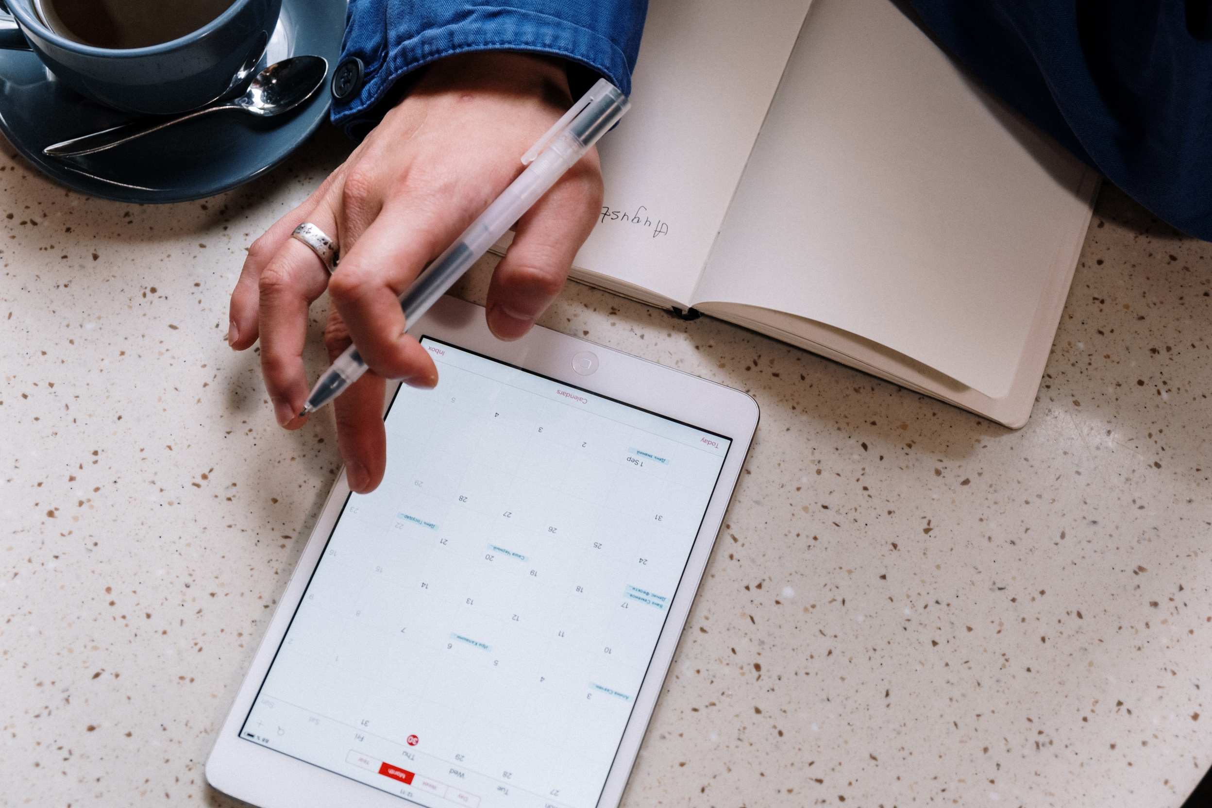
Solution Overview
Team A
Project Summary
What We Created
We designed a lightweight digital planner made for students who want to stay organized without feeling overwhelmed.
What It Does
Allows users to create and manage tasks effortlessly
Offers a distraction-free “focus mode” for study or work
Provides customizable reminders and alerts
Syncs data across multiple devices
Supports offline access for uninterrupted use
8

Slide 9
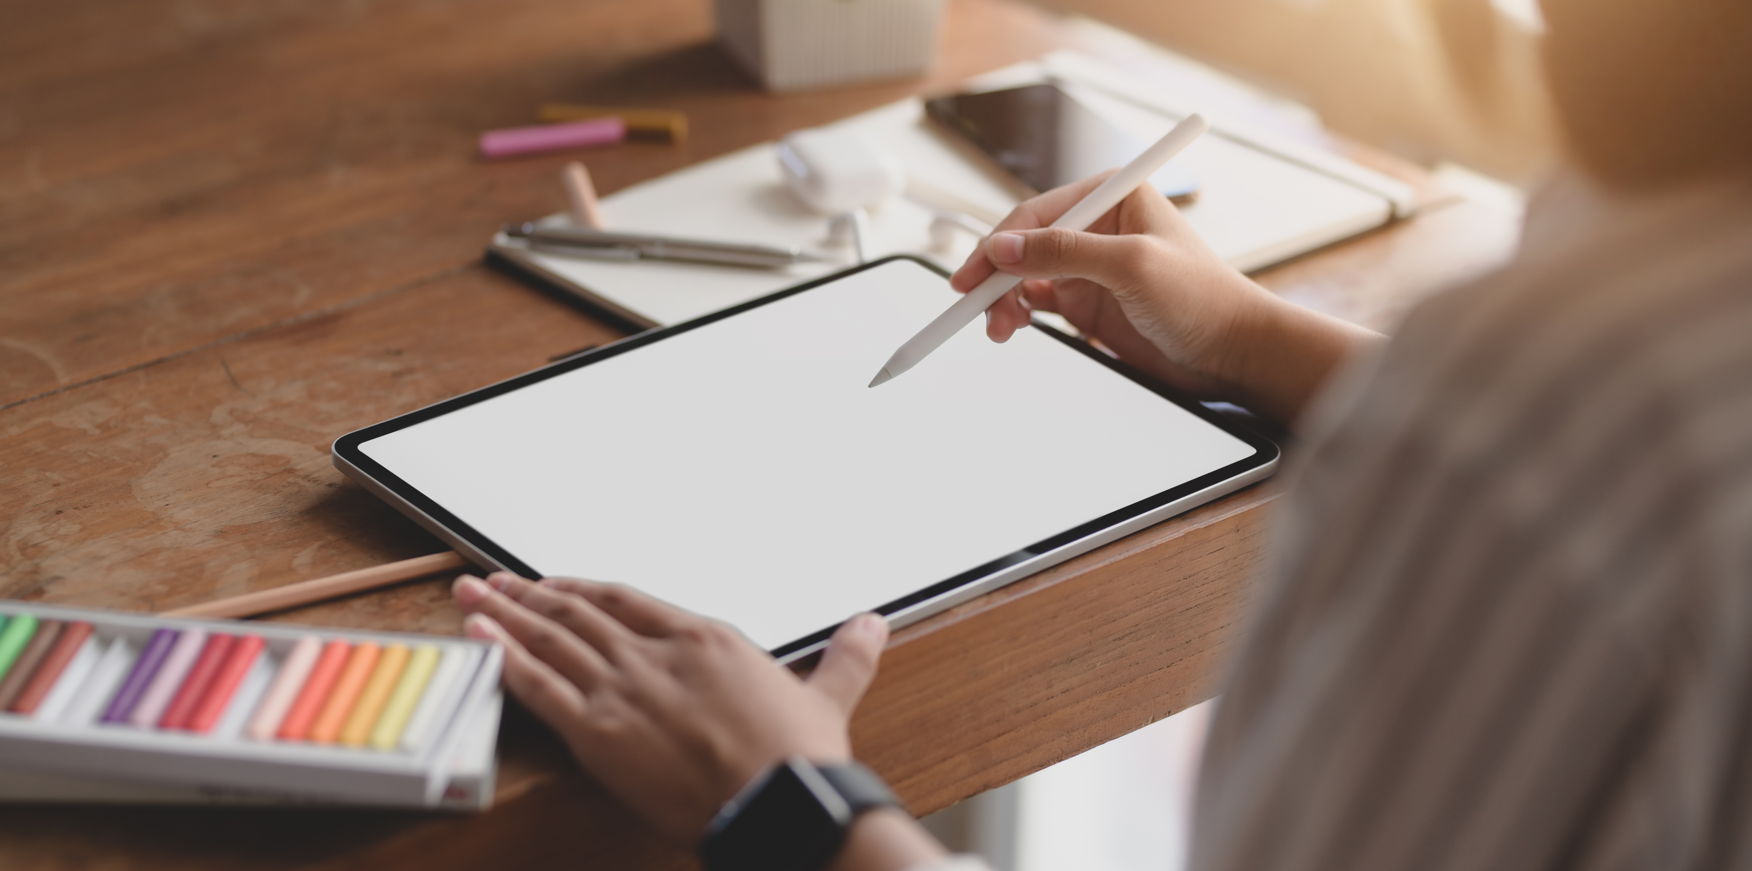
Key Features
Team A
Key Features
Our final design includes a set of focused features aimed at enhancing usability and effectiveness. These include a clean visual layout for easy navigation, a drag-and-drop task scheduler, gentle reminders to reduce stress, and an offline mode for uninterrupted access. Each component was chosen to support the user’s productivity while keeping the interface simple and distraction-free.
9

Slide 10
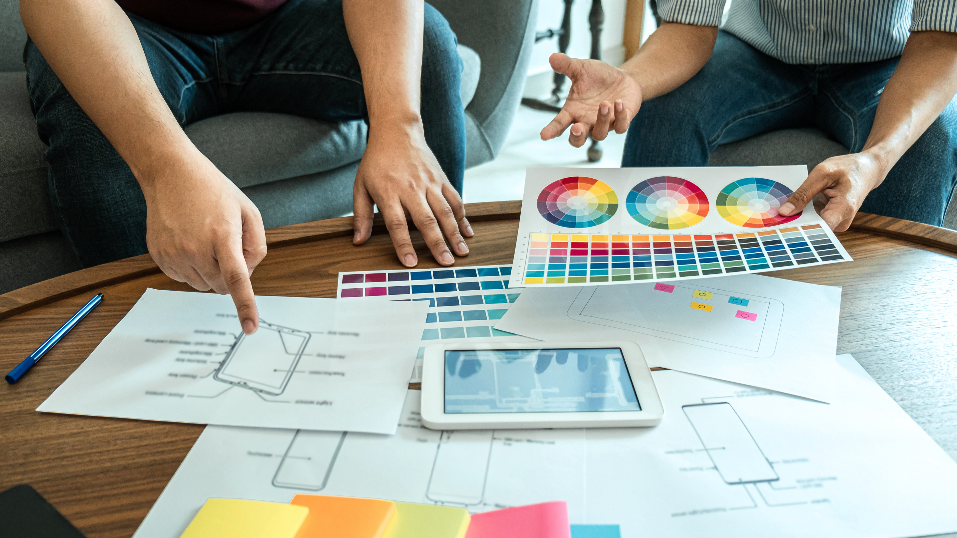
Prototype
Team A
Simple layout with today’s tasks and quick notes
Drag-and-drop interface to organize your week
Minimal screen with timer and soft reminders
10

Slide 11
Challenges Faced
Team A
Challenge 1
Challenge 2
Narrowing the Scope
User Testing Feedback
We started with too many ideas and had to make hard decisions about what to keep and what to let go. Prioritizing the most valuable features helped us stay focused.
Some feedback conflicted with our original plan. It was challenging to adjust without losing our core concept, but we chose the suggestions that best supported our goals.
11

Slide 12
Reflections & Growth
Team A
What We Learned
Personal Skills Gained
Team Collaboration Lessons
We learned how to manage time effectively, communicate ideas clearly, and stay organized under pressure.
We realized the importance of dividing tasks based on each member’s strengths and checking in regularly to avoid misunderstandings.
Problem-Solving Insights
Adaptability
Through user feedback and iteration, we learned that simple solutions often work better than complex ones. Listening actively was key.
When some ideas didn’t work as expected, we learned how to pivot quickly and stay focused on the end goal.
12

Slide 13
Studio ShodwE
The End
TEAM A
Drew Feig
Eleanor Fitzgerald
Estelle Darcy
Donna Stroupe

